Slide 1
ECIMS Extensible Computerized Inventory Management System
Team Presentation | 2025

Slide 2
Video

Slide 3


CONTENTS
Meet the Team
Introduction
Key Features
Technologies Used
Development Process
Release Stages
CI/CD Pipeline
Current Status
Future Plans
Live Demo
Q&A

Slide 4






Meet the team
Gabriela Caetano De Jesus
Team Lead
Frontend Lead & Developer
Joana Villanova
Frontend Developer
Kate Howell
Backend Developer
Project Management
Jonathan Cockrell
Backend Lead & Developer
QA Lead
Odai Alkhatib
Backend Developer
Visar Rraci
Frontend Developer

Slide 5
Introduction
Problem: Single-location businesses struggle with inventory tracking due to lack of user-friendly, scalable tools and affordability.
Opportunity: ECIMS provides a simple, intuitive, and extensible platform for inventory management.

Slide 6
Key Features
Role-based access and permissions
Red flag stock alerts
Order management workflow
Change log and order history
Modular design for future expansion

Slide 7


Technologies Used
Backend:
Python, Django, Django REST Framework
Frontend: JavaScript, HTML, Bootstrap, Figma
Authentication: Django Auth, DRF Token
Database:
SQLite, Postgres
Deployment:
Heroku
Tools:
GitHub, Slack, Postman

Slide 8
Development Process
Project Management
Utilize formatted GitHub issues to track project tasks
Track each month-long sprint for Spring 2025 using GitHub
Project Planning
Roadmaps: Developed project roadmap to outline overall project goals
Monthly Sprints: Break down project goals into monthly sprints for focused, achievable objectives
Sprint Retrospectives
Conduct retrospectives to review completed work, identify areas for improvement, and prioritize for next sprint
Communication
Twice Weekly Standups: Team communication regarding progress on respective GitHub issues in front of team
Consistent communication through Slack
Ensure sprints are completed as efficiently as possible

Slide 9
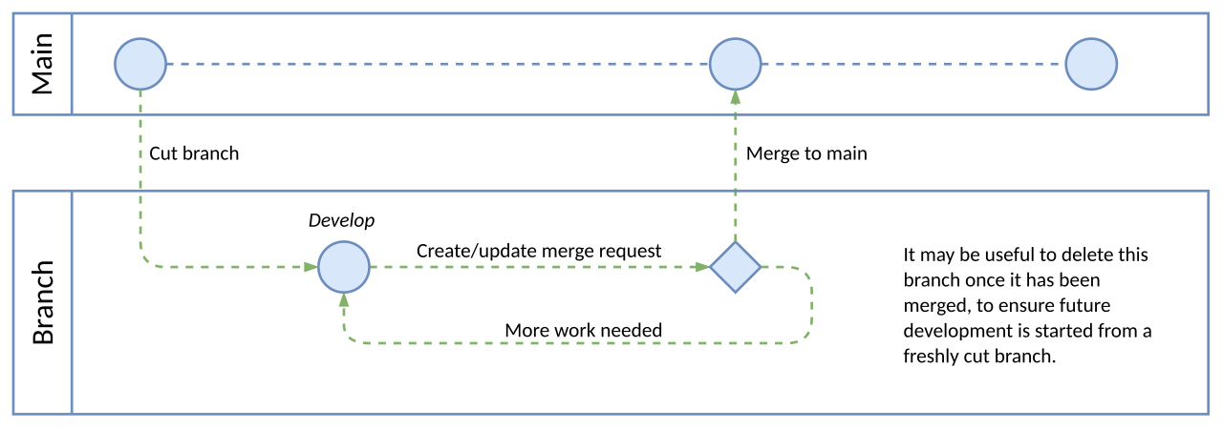
Software Release Stages
Key Activities: Load testing, real-world feedback
Purpose: Stable, public release
Audience: All users/customers
GA Release (General Availability)
Key Activities: Release notes, support readiness, monitoring
Alpha Release
Purpose: Internal validation, early testing
Audience: Developers, QA, internal stakeholders
Features: Incomplete, unstable, fast iterations
Key Activities: Unit tests, integration tests, feature flags
Beta Release
Purpose: Wider testing with real users
Audience: Select external users
Features: Fully functional, scalable, supported
Features: Feature-complete, may have known issues
Figure 1: Basic git branching workflow (CC-BY-SA-4.0)
https://commons.wikimedia.org/wiki/File:Basic_git_branching_workflow_%28GitLab%29.svg
Notes:
Project Stats:
107 issues
30 branches

Slide 10
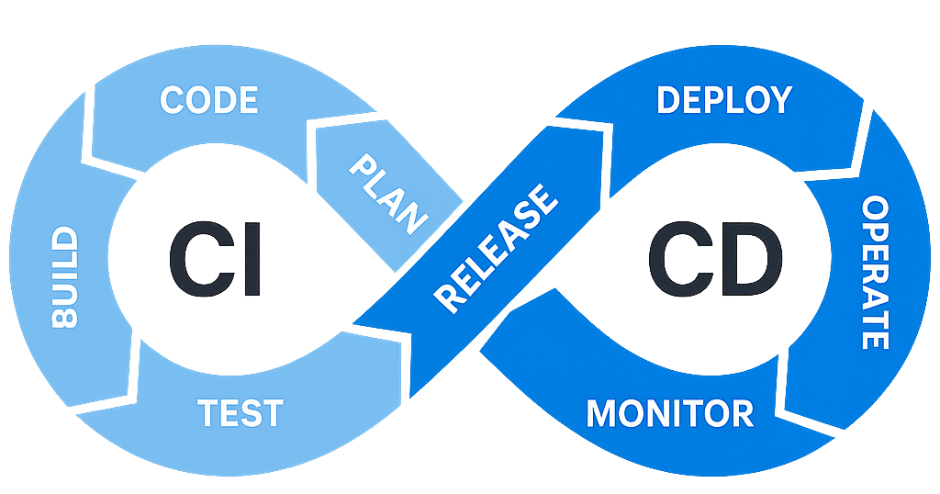
CI/CD Pipeline
HTML, JavaScript, Bootstrap, jQuery
Django (Python)
GitHub
VSCode
GitHub Issues(Tasks)
Figma
Slack
Microsoft OneDrive
Heroku Dashboard
Git
pip
Django Authentication
DRF Token
Gunicorn
PostgreSQL
pip
Django
SQLite
GitHub Pull Requests
Team reviews and approves
SQLite
Postman
Manual browser
Heroku Logs
Google Forms
Notes:
Slack – Synchronous and asynchronous planning, meetings, and video chats
OneDrive – Non-text files
Heroku Dynos
Gunicorn – Web Server Gateway Interface for managing threading and scaling

Slide 11

Current Status
Minimum Viable Product (MVP) complete
Core features: Inventory Management, Orders, Suppliers, Changelog
All features accessible by API calls
Continuing testing and debugging

Slide 12
Future Plans
Short Term:
UI/UX improvements
Shipment tracking
Long Term:
POS system integration
Enhanced notifications
Automated order processing
Predictive Analytics/AI

Slide 13
LIVE DEMO

Slide 14


Q&A
Thank you for your attention!
We welcome your questions and feedback.
Scan the QR code to access our public GitHub repository

